Slide 1
Incident Management Planning Process

Slide 2
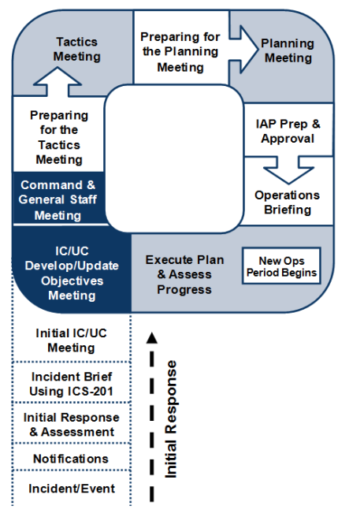
The Planning “P”

Slide 3
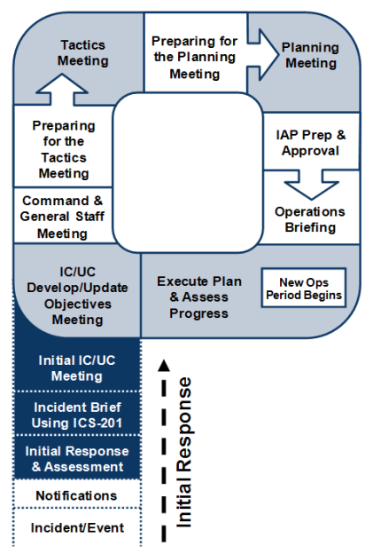
Initial Response
Planning begins with a thorough size-up that provides information needed to make initial management decisions.
The ICS Form 201 provides Command Staff with information about the incident situation and the resources allocated to the incident. This form serves as a permanent record of the initial response to the incident and can be used for transfer of command.

Slide 4
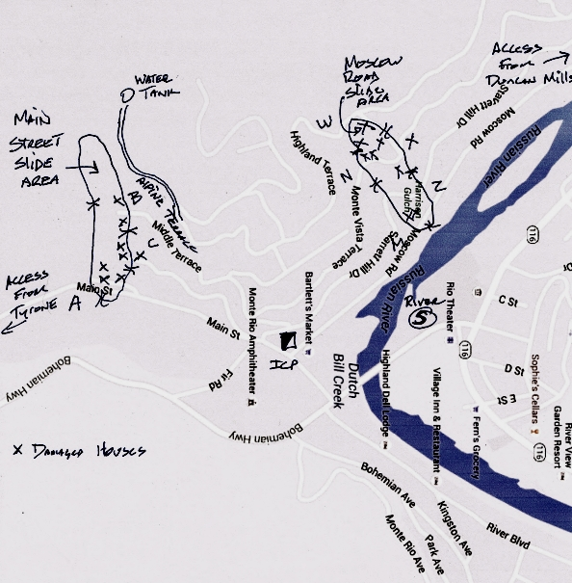
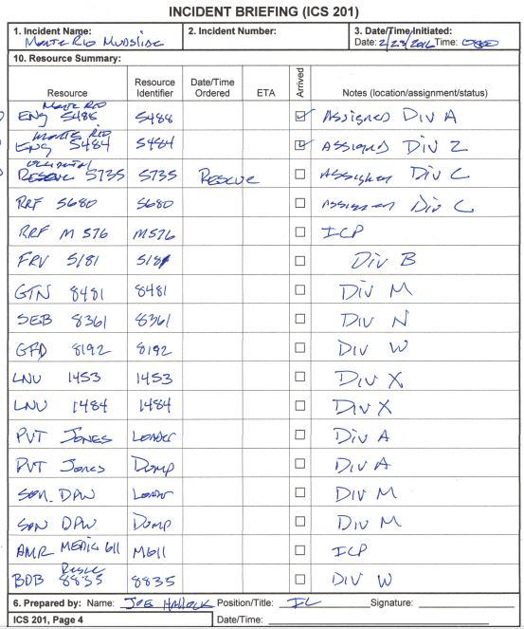

Slide 5
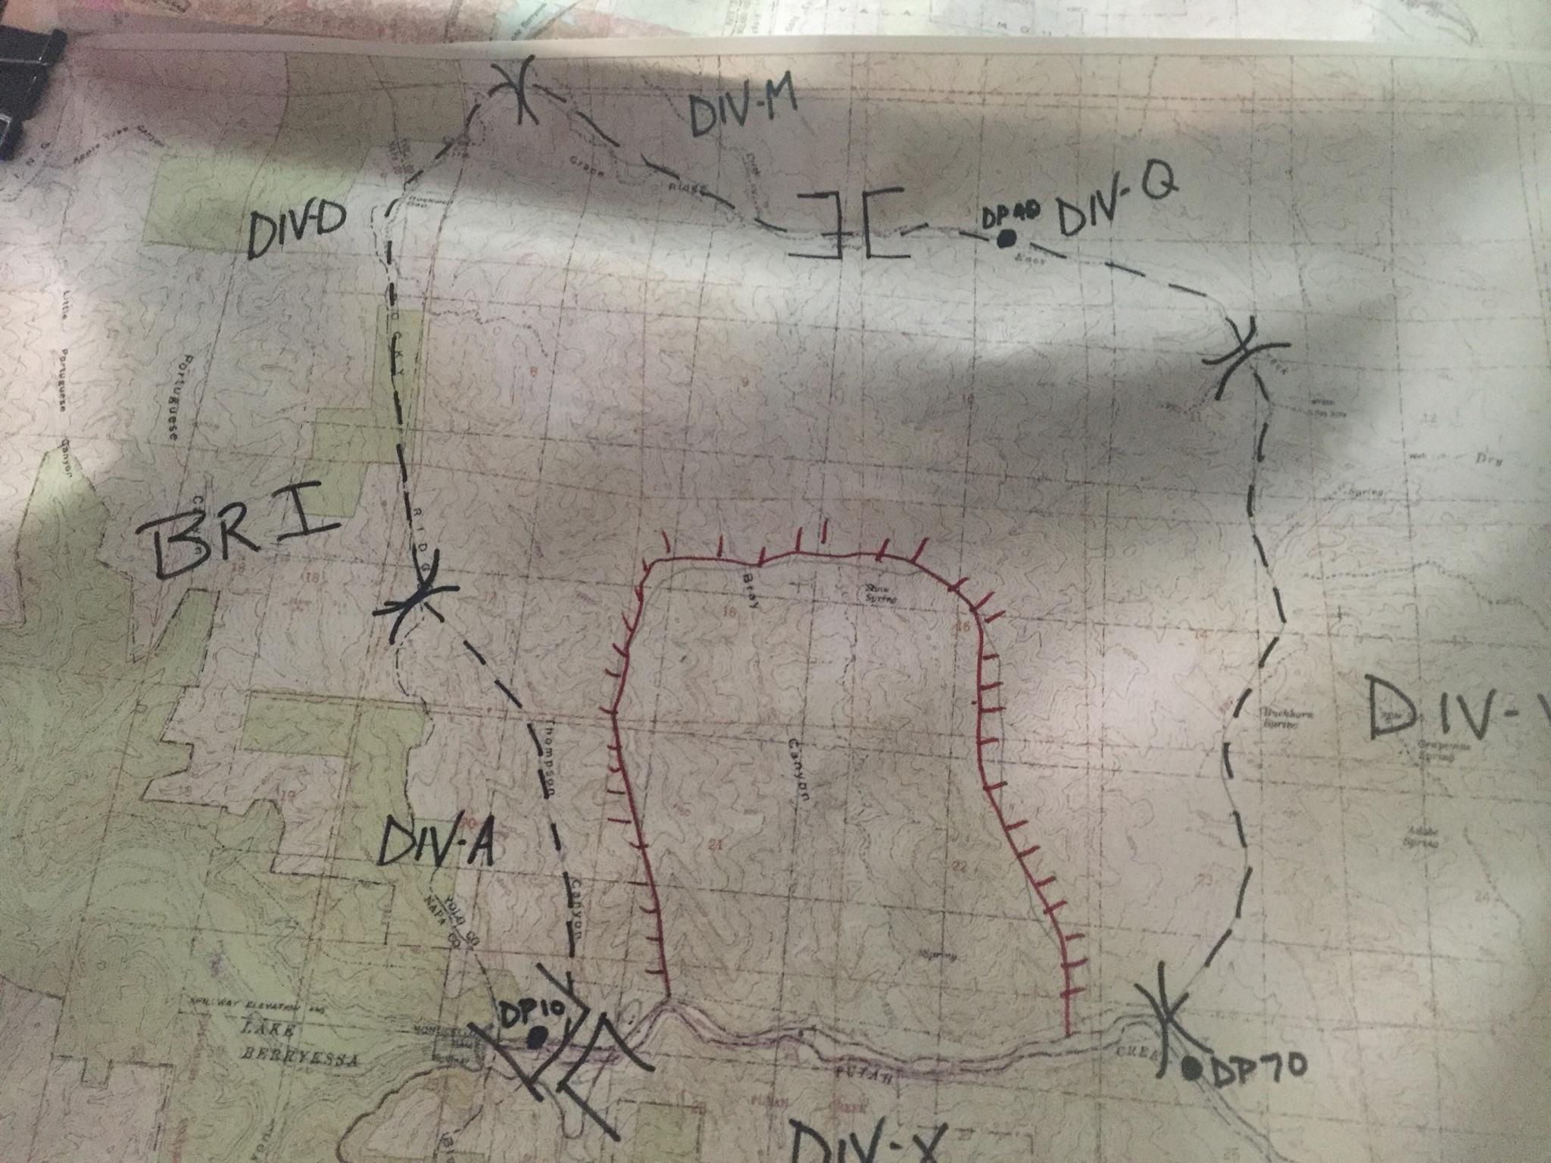
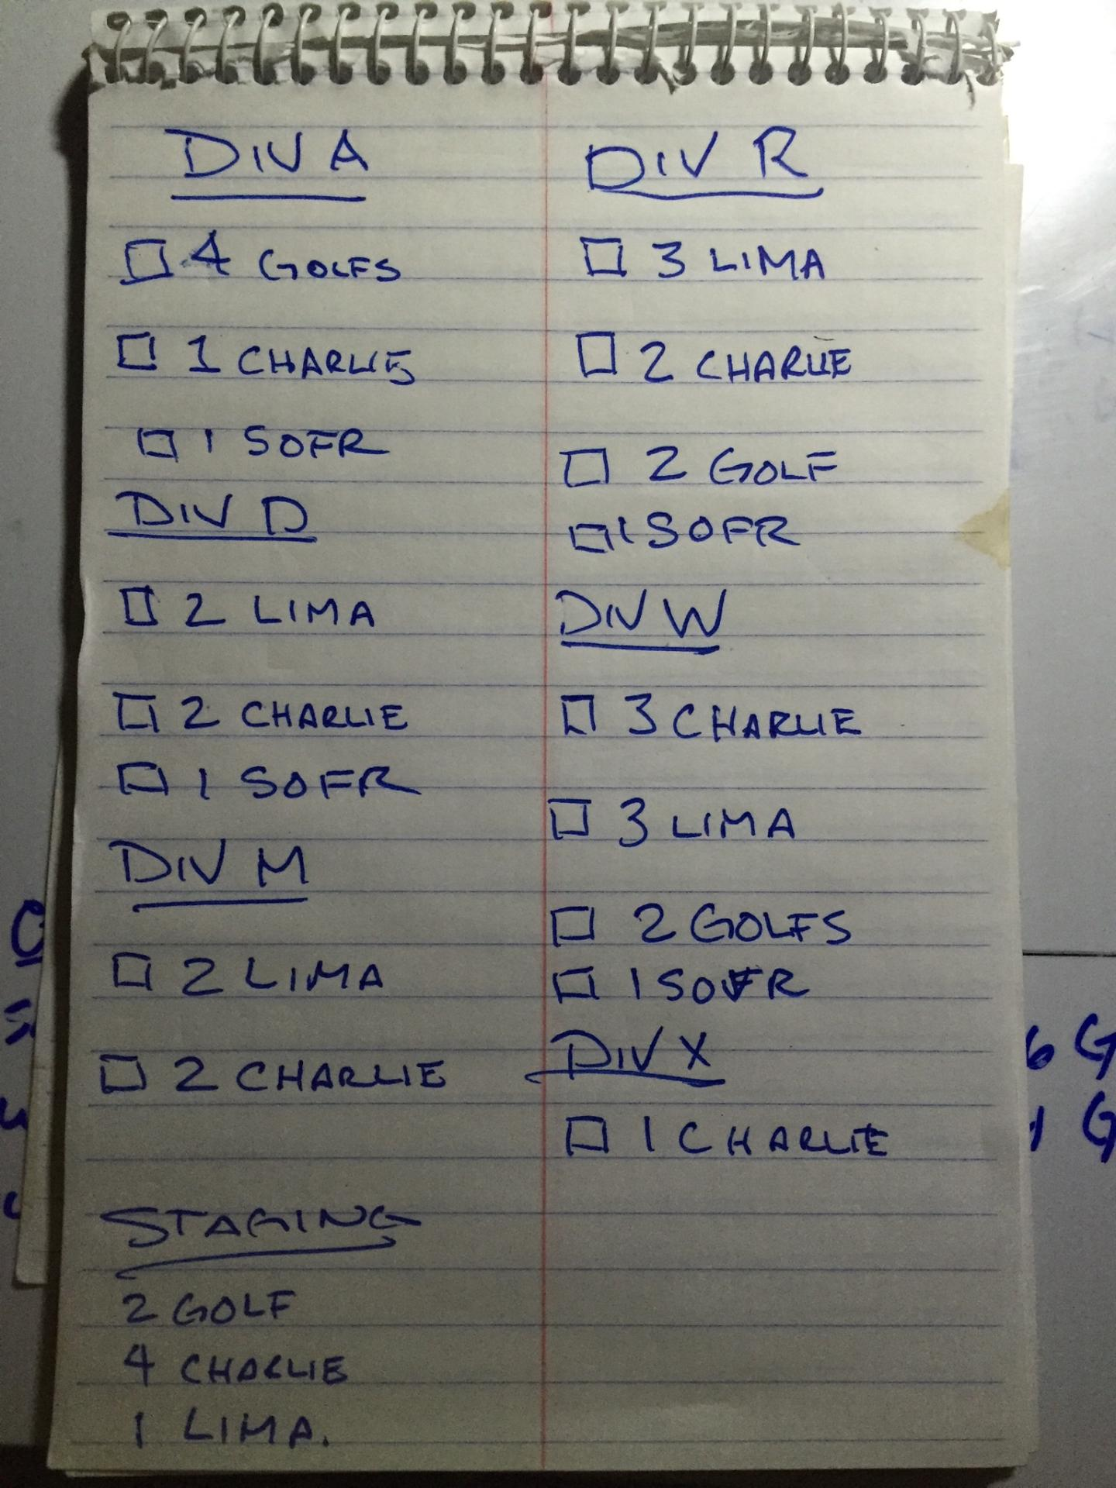

Slide 6
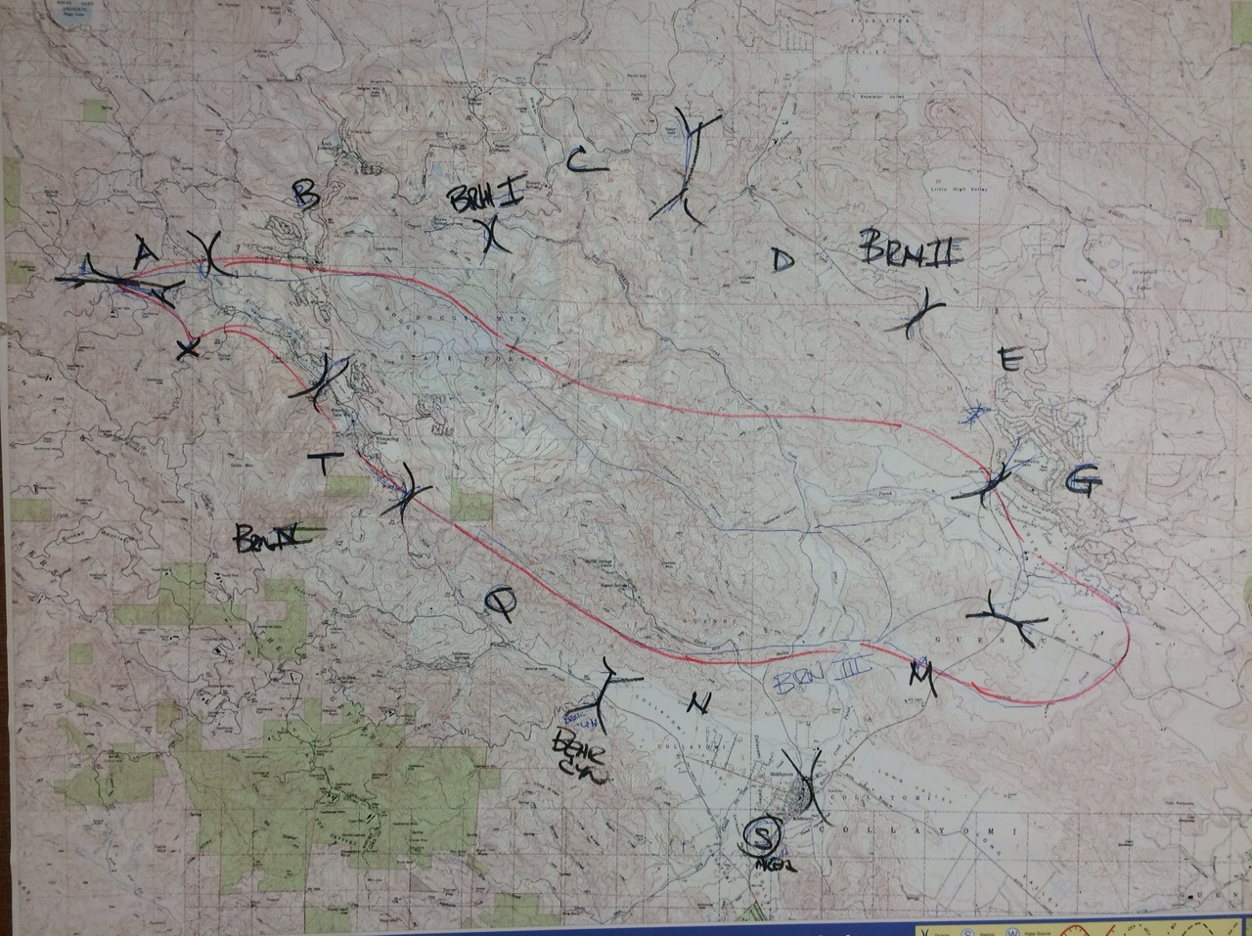
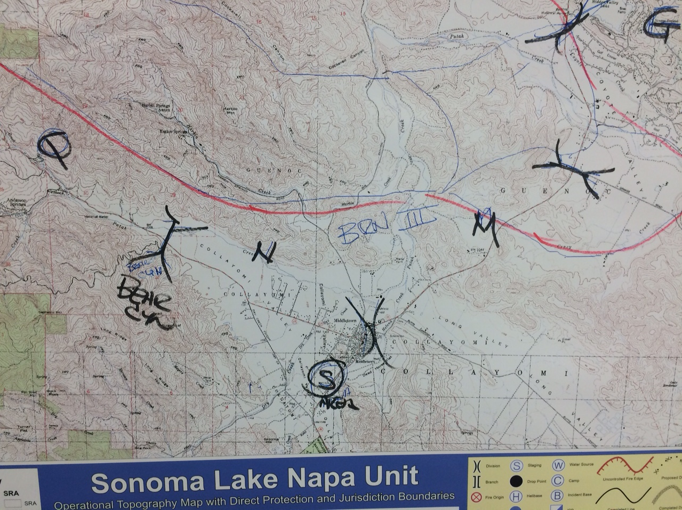

Slide 7
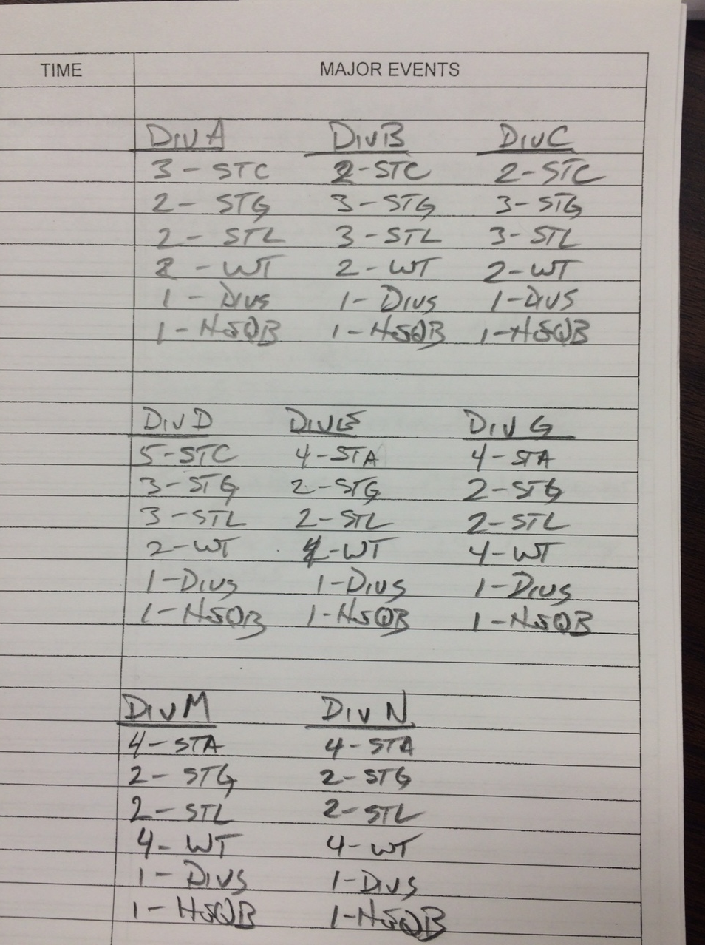
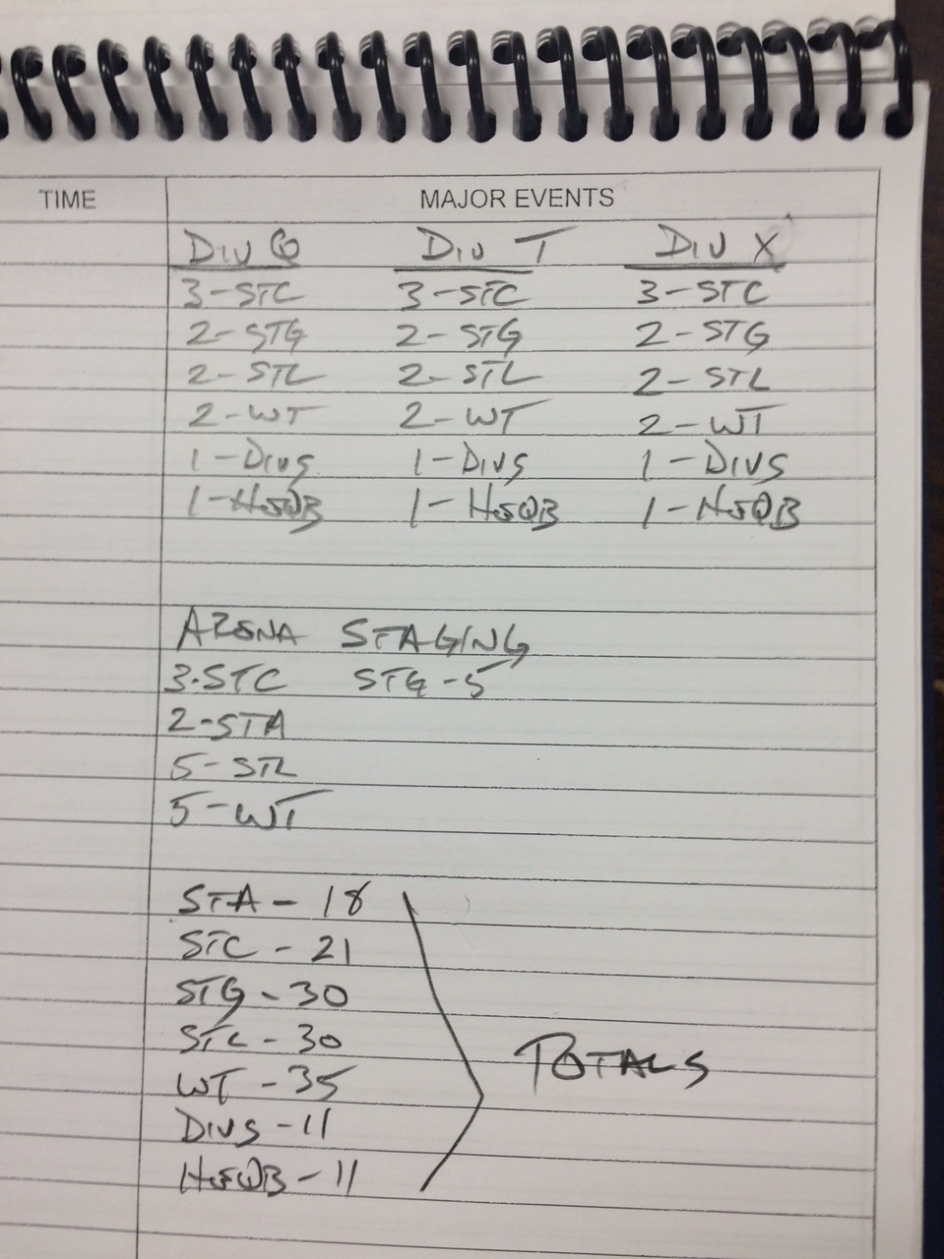

Slide 8
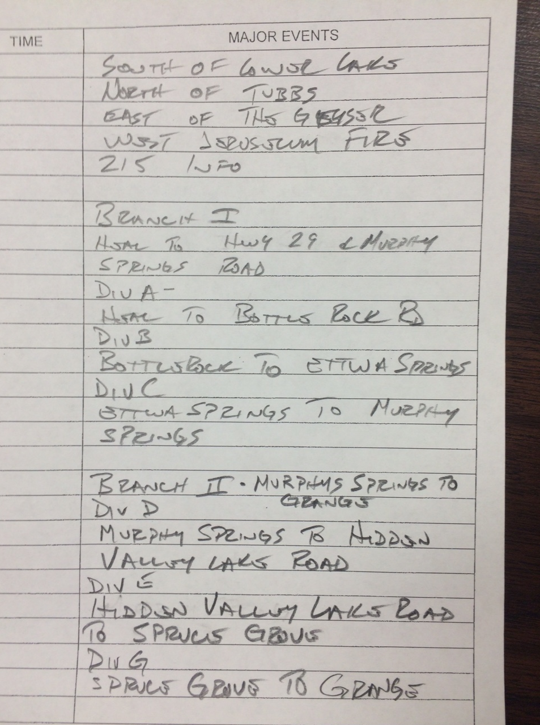
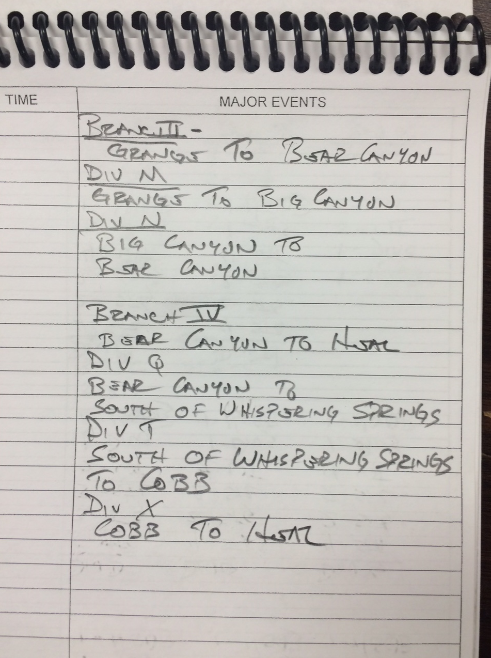

Slide 9
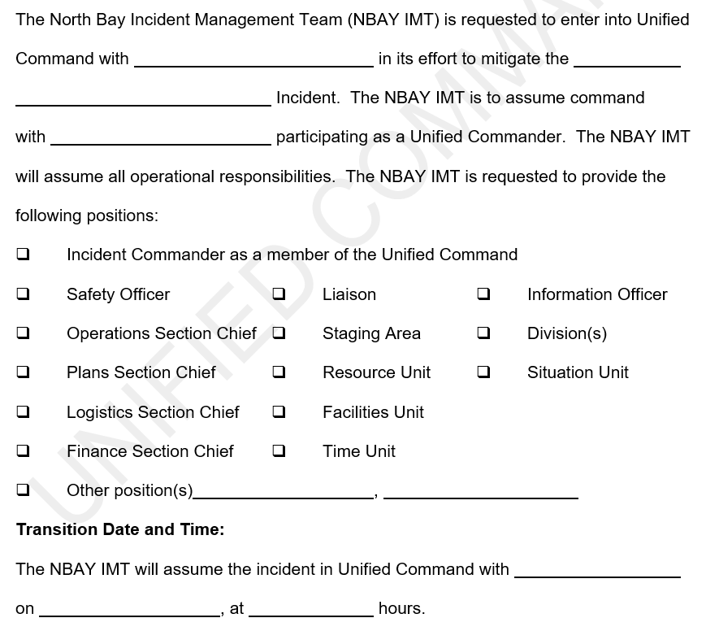

Slide 10
The Start of Each Planning Cycle
IC/UC Objectives Meeting: The Incident Command/Unified Command establish incident objectives that cover the entire course of the incident.
Command and General Staff Meeting: The Incident Command/Unified Command may meet with the Command and General Staff to gather input or to provide immediate direction that cannot wait until the planning process is completed. This meeting occurs as needed and should be as brief as possible.

Slide 11
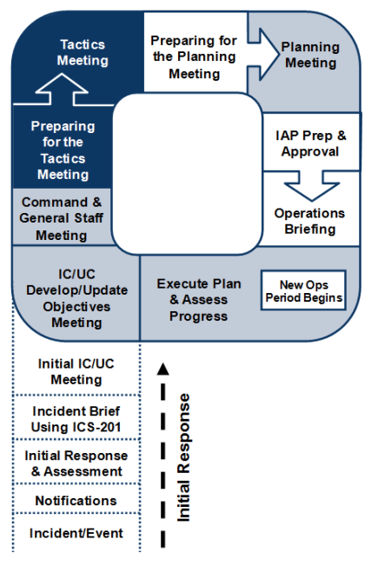
Preparing for and Conducting the Tactics Meeting
The Operations Section Chief, Safety Officer, Logistics Section Chief, and Resources Unit Leader attend the Tactics Meeting. The Operations Section Chief leads the Tactics Meeting.
The purpose of the Tactics Meeting is to review the tactics developed by the Operations Section Chief.
The ICS Forms 215, Operational Planning Worksheet, and 215A, Incident Safety Analysis, are used to document the Tactics Meeting.
Resource assignments will be made for each of the specific work tasks. Resource assignments will consist of the kind, type, and numbers of resources available and needed to achieve the tactical operations desired for the operational period.
Notes:
If the required tactical resources will not be available, then an adjustment should be made to the tactical assignments being planned for the Operational Period.
It is very important that tactical resource availability and other needed support be determined prior to spending a great deal of time working on strategies and tactical operations that realistically cannot be achieved.

Slide 12
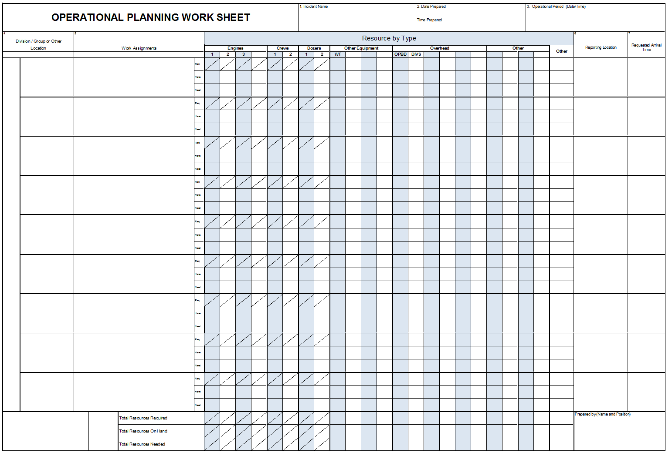

Slide 13
FOBS
2 3 2 2
2 1 2
DIV A
Provide structure protection
and direct fire suppression
1 2 0 1 2 1 0
1 1 2 1 0 0 2

Slide 14
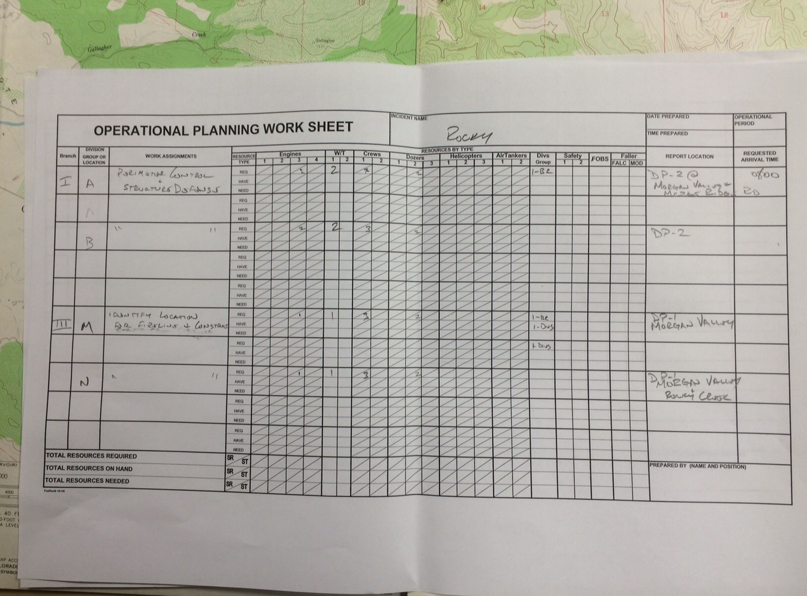

Slide 15
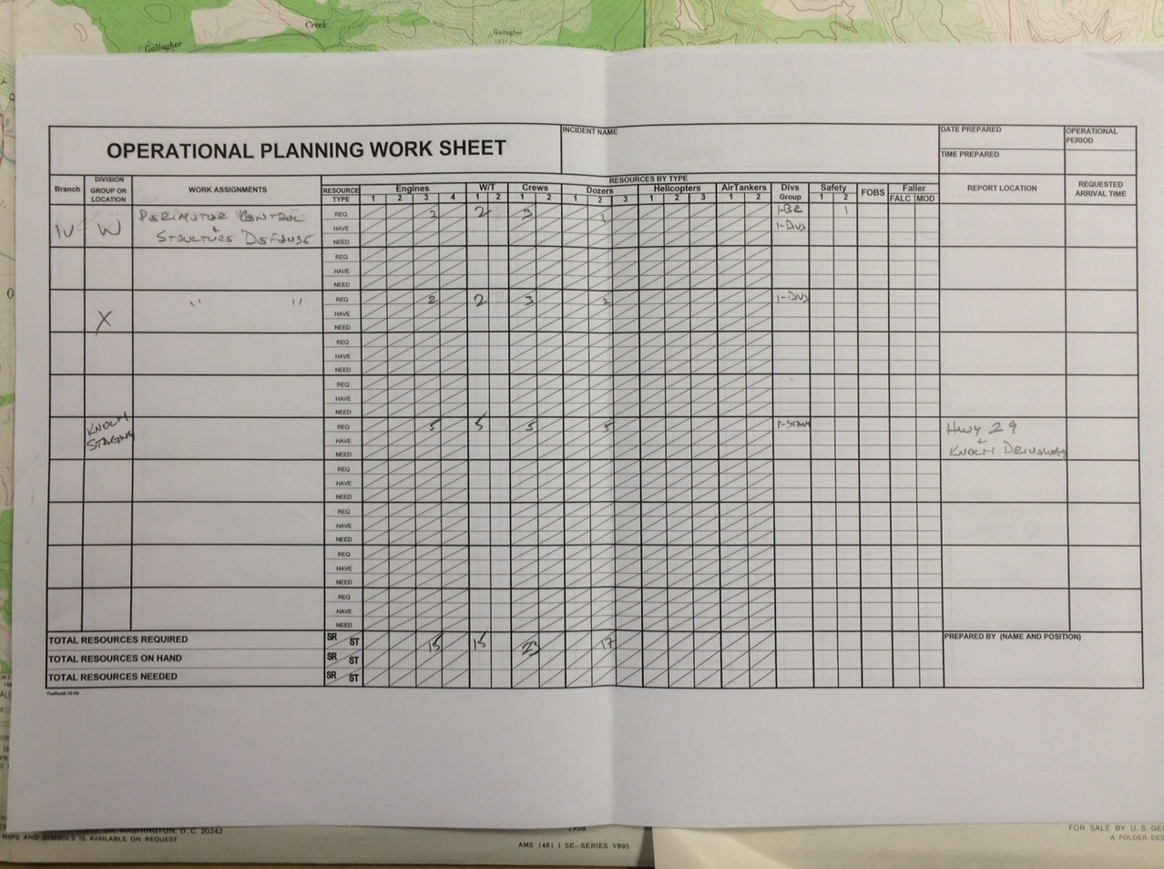

Slide 16
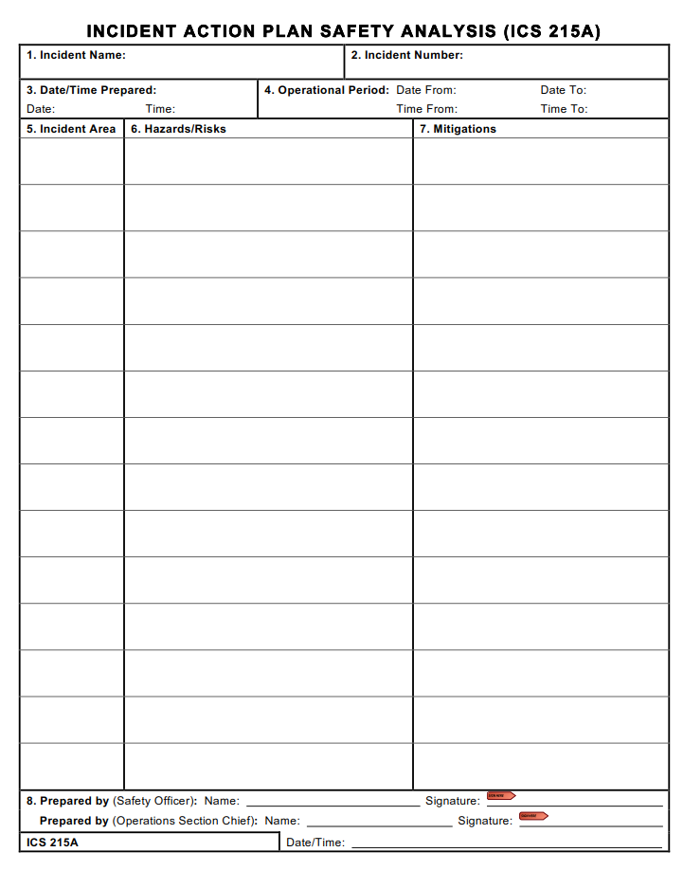

Slide 17
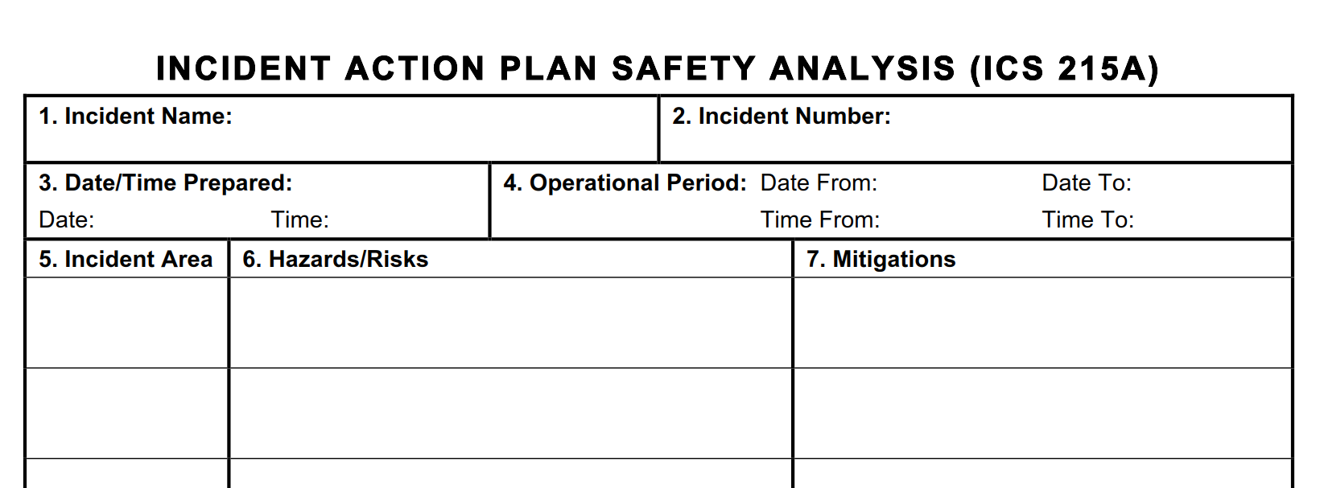
The Big One
XMR 17-0045
5/16/16 0700
5/17/16 0700
5/15/16
2200
Be alert for signs of fatigue and take breaks as necessary. Drink water before, during and after your shift.
All FATIGUE
Drive defensively! Expect the unexpected around
every turn.
Drive with headlights on, use wheel chocks and
always look before backing.
Increase following distances on dusty roads.
Drive defensively! Expect the unexpected around every turn. Drive with headlights on, Increase following distances
Div A
Narrow roads with blind curves

Slide 18
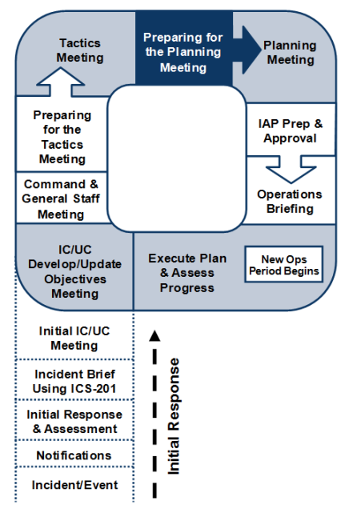
Preparing for the Planning Meeting
Following the Tactics Meeting, preparations are made for the
Planning Meeting, to include the following actions coordinated
by the Planning Section:
Review the ICS Form 215 developed in the Tactics
Meeting.
Review the ICS Form 215A, Incident Safety Analysis
(prepared by the Safety Officer), based on the
information in the ICS Form 215.
▪ Assess current operations effectiveness and resource
efficiency.
▪ Gather information to support incident management
decisions.

Slide 19
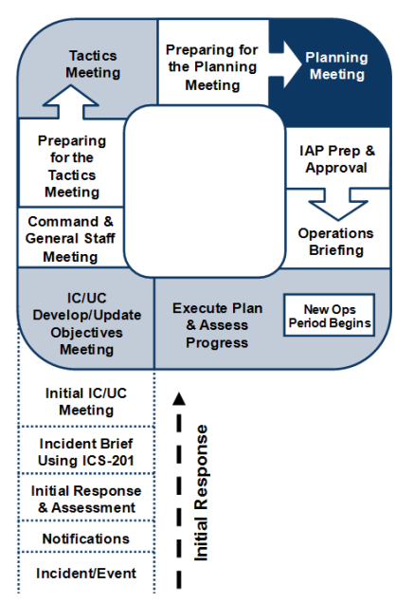
Planning Meeting
Opportunity for the Command and General Staff to review and validate the operational plan as proposed by the Operations Section Chief.
All Command and General Staff. The Planning Section Chief conducts the Planning Meeting.
At the conclusion of the meeting, the Planning Section Staff will indicate when all elements of the plan and support documents are required to be submitted.

Slide 20
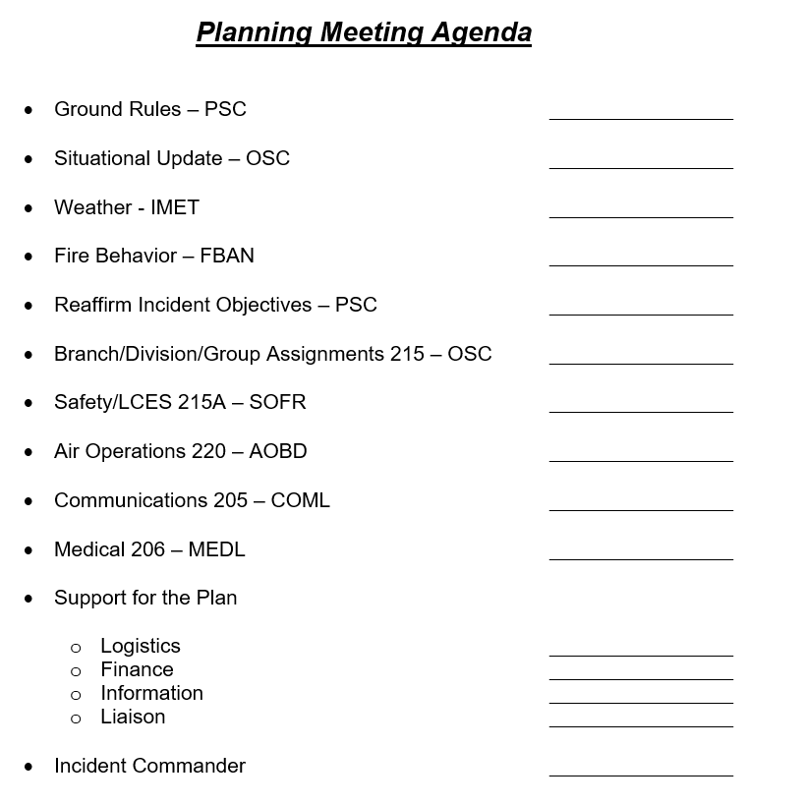

Slide 21
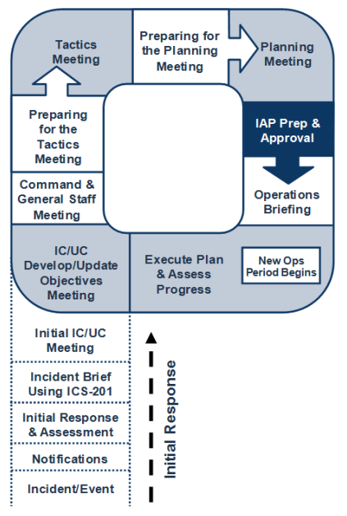
IAP Preparation and Approval
The next step in the Incident Action Planning Process is plan
preparation and approval. The written plan is comprised of a
series of standard forms and supporting documents that
convey the Incident Commander’s intent and the Operations
Section direction for the accomplishment of the plan for that
Operational Period.
Standard Components include”
202 – Incident Objectives
203 – Organizational Assignment List
204 – Division Assignment List
205 – Communications Plan
206 – Medical Plan
208 – Safety Plan
215A – IAP Safety Analysis
220 – Air Operations Summary
Weather Forecast
Incident Maps – Operations, Travel, Base
214 – Activity Log (Blank)

Slide 22
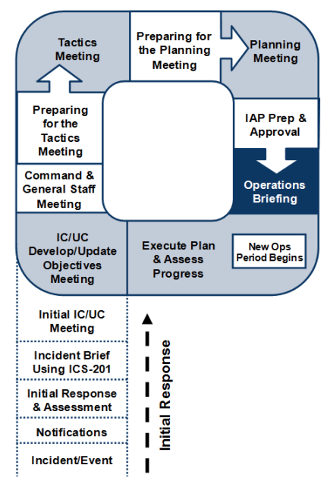
Operations Period Briefing
The Operations Period Briefing may be referred to as the Operational Briefing or the Shift Briefing. This briefing is conducted at the beginning of each Operational Period and
presents the Incident Action Plan to supervisors of tactical resources.
Following the Operations Period Briefing supervisors will meet with their assigned resources for a detailed briefing on
their respective assignments.

Slide 23
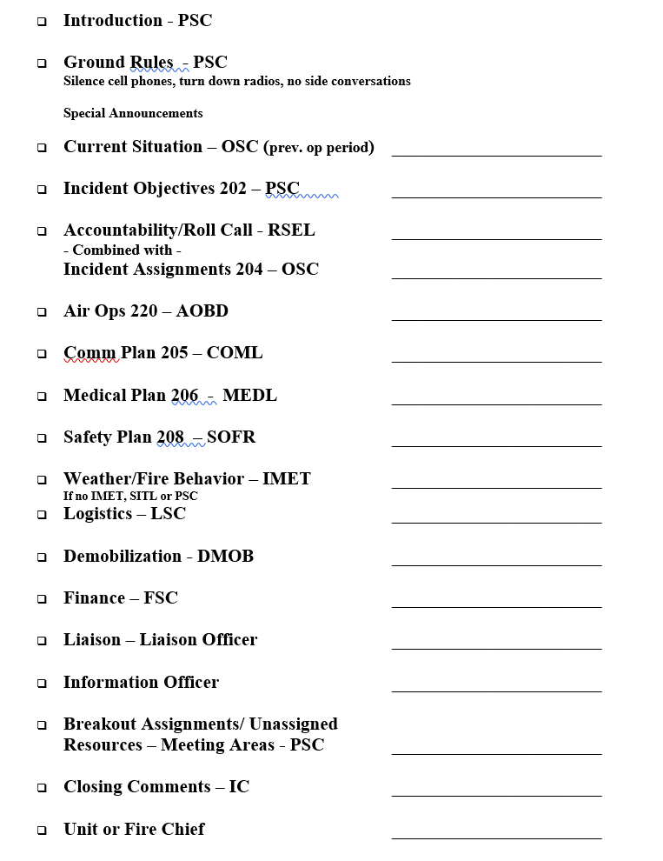

Slide 24
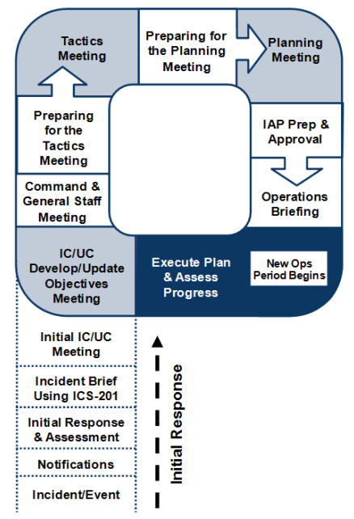
Execute Plan and Assess Progress
The Operations Section directs the implementation of the plan. The supervisory personnel within the Operations Section are responsible for implementation of the plan for the specific Operational Period.
The plan is evaluated and progress is assessed.
Based on progress, Objectives are updated or deemed to be still valid.
Process starts over

Slide 25
Questions - Comments

